Slide 1
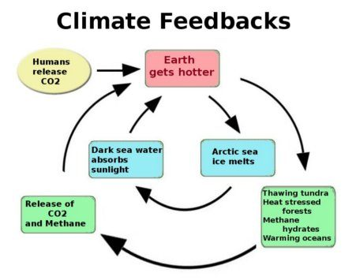
Positive feedbacks we’ve touched on so far: The Henry effect (Implemented in Cambio 2.0)

Slide 2
Incorporating ice-albedo feedback into our carbon mass balance (Cambio 3.0)

Slide 3
Incorporating ice-albedo feedback into our carbon mass balance (Cambio 3.0)

Slide 4
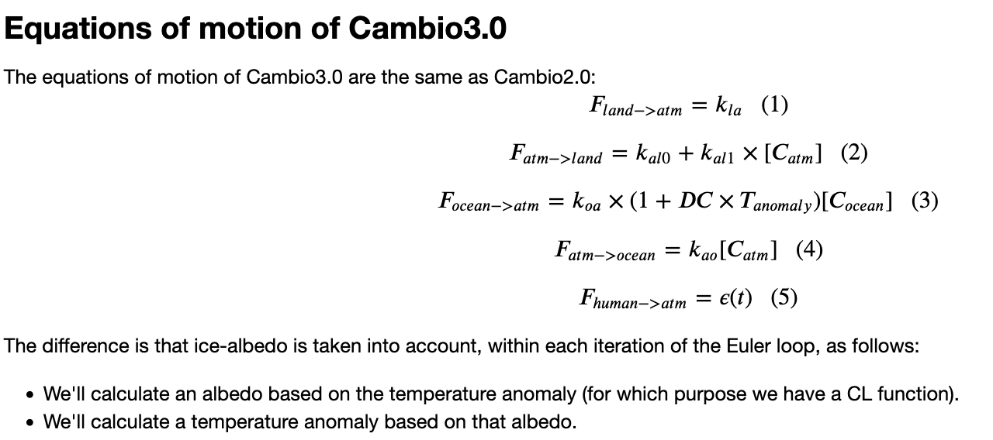
OK, let’s get started

